Slide 1
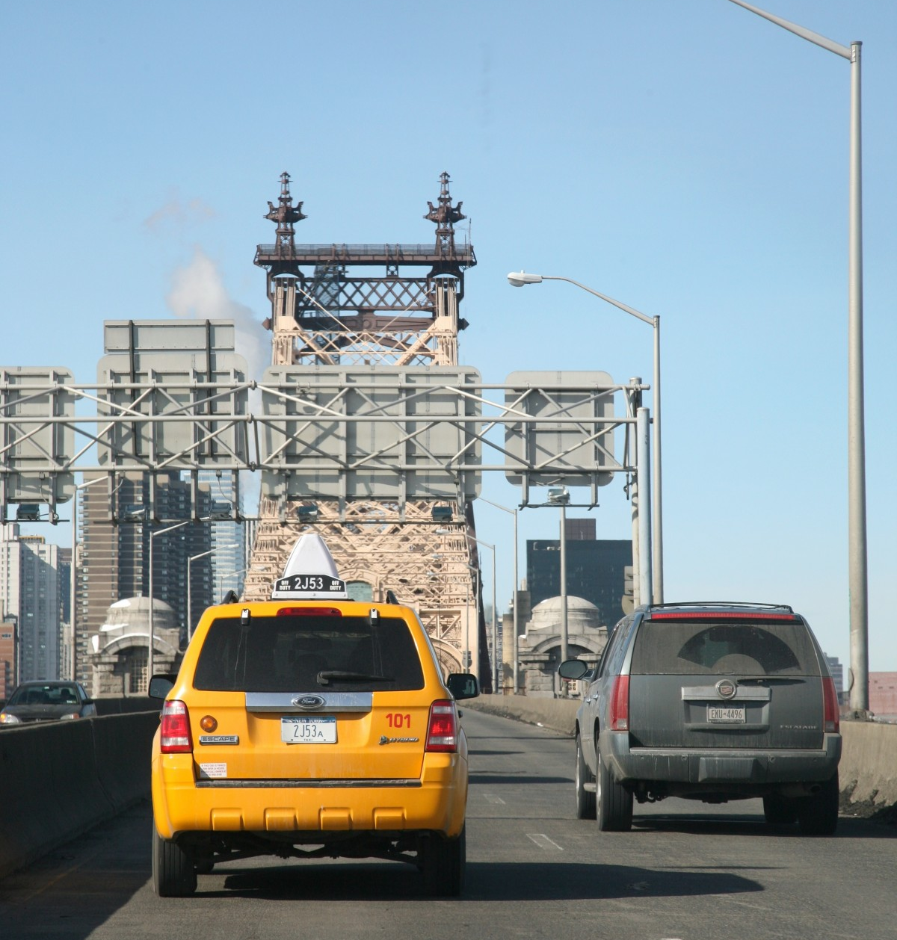
Picture fuzzy incident graph

Slide 2
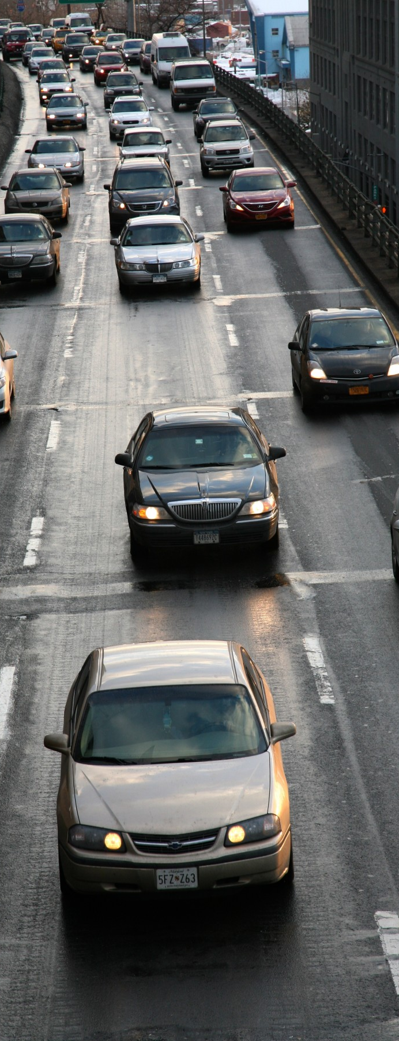
AGENDA
Problems
Main idea
Input / Output of data
AI model / Algorithms
Expected results
Experiment and evaluation
Conclusion

Slide 3
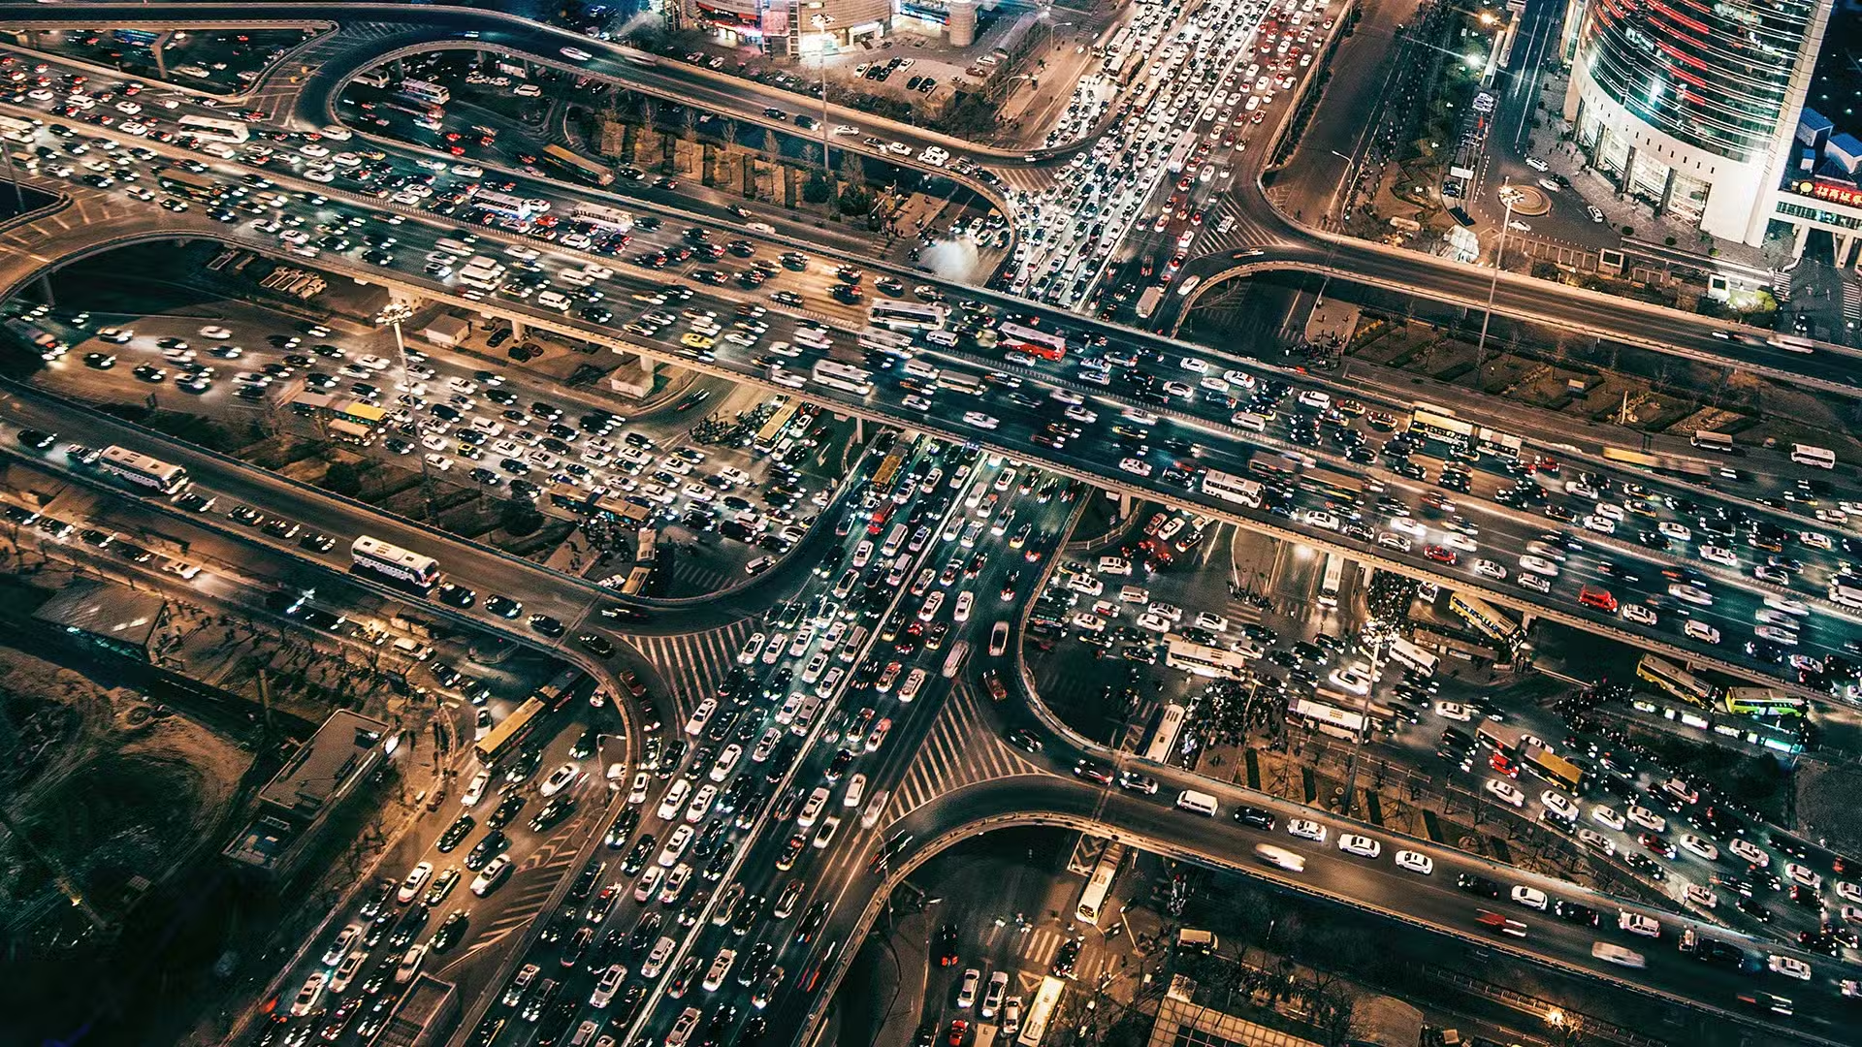
Problems
In the complex traffic scenario, finding the optimal route for vehicles is a significant challenge.
We need to determine the best routes based on various criteria such as travel time, fuel consumption, and avoiding traffic congestion.

Slide 4
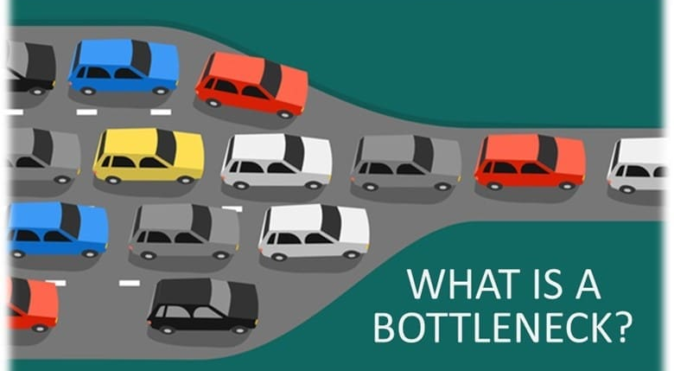
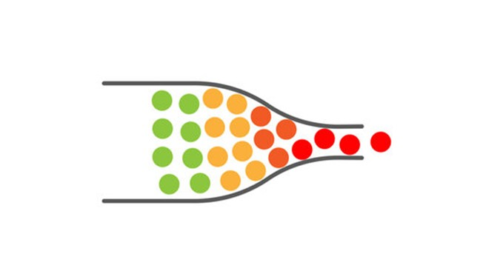
Main idea
PFIG is a method that uses Picture Fuzzy Sets to evaluate and represent routes and intersections in the graph. This approach helps to handle the uncertainty and multi-valued nature of the data.
In PFIG, we find PFICP ( bottleneck ) to reduce traffic jam and boost traffic flow faster.

Slide 5
Input / Output data
•Input data:
PFS is described by three components: Positive Membership (PM), Neutral Membership (NM), and Negative Membership (nM) of an element, satisfying 0 ≤ PM + NM + nM ≤ 1
For example, with this data to the destination HUST;
(Mỹ Đình, Mỹ Đình–Nguyễn Chí Thanh)
P_M = 0.1,N_M = 0.2,n_M = 0.3
P_M= 0.1, percentage of people who intend to reach HUST by this road.
N_M = 0.2, percentage of people who are unsure to reach HUST by this road.
n_M= 0.3, percentage of people who not planning to reach HUST by this road.
•Output data:
Which routes are PFICPs and the optimal route based on the evaluations of the algorithms and the PFS values.

Slide 6

Ai model / Algorithms
Step 1: Define the Problem
Step 2: Presentation
Step 3: Build Fuzzy Incidence Matrices
Step 4: Evaluate and select the Best Route
Step 5: Optimization

Slide 7
Step 1: Define the Problem
Minimum travel time
Low fuel consumption
Avoiding traffic congestion
Clearly define the criteria to determine the "best" route from point A to B: minimum travel time, low fuel consumption, avoiding traffic congestion….

Slide 8
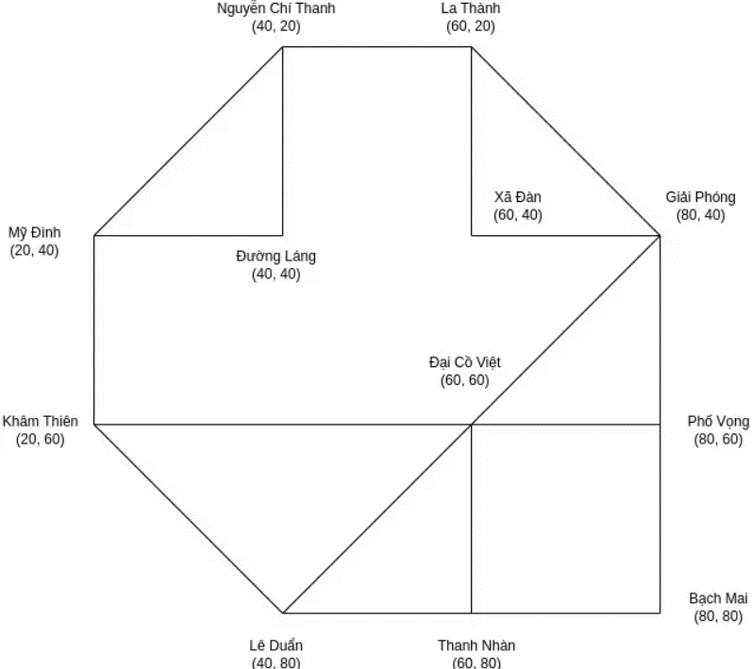
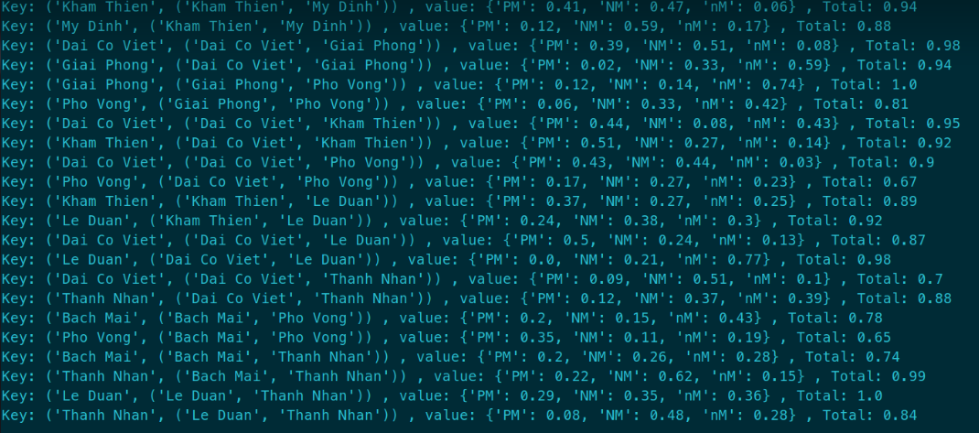
Step 2: Presentation
Step 3: Build Fuzzy Incidence Matrices
Describe the problem in the form of a graph, with vertices representing streets' name and edges representing routes.
For each vertex and edge in the graph, construct a fuzzy incidence matrix to describe the relationship between vertices and edges.

Slide 9
Step 4: Evaluate and select the Best Route
At first, we use FPIG to determine PFICP and after that we add some algorithms to find the best route: A*, BFS, DFS.
A* (A-star)
The A* algorithm is a pathfinding algorithm used to find the shortest path from a start node to an end node in a graph. It uses a cost function that combines the actual cost and the estimated remaining cost to find the optimal path.
BFS (Breadth-First Search) and DFS (Depth-First Search)
•BFS: Breadth-First Search, explores all nodes at the present depth level before moving on to nodes at the next depth level.
•DFS: Depth-First Search, explores as far down a branch as possible before backtracking.

Slide 10
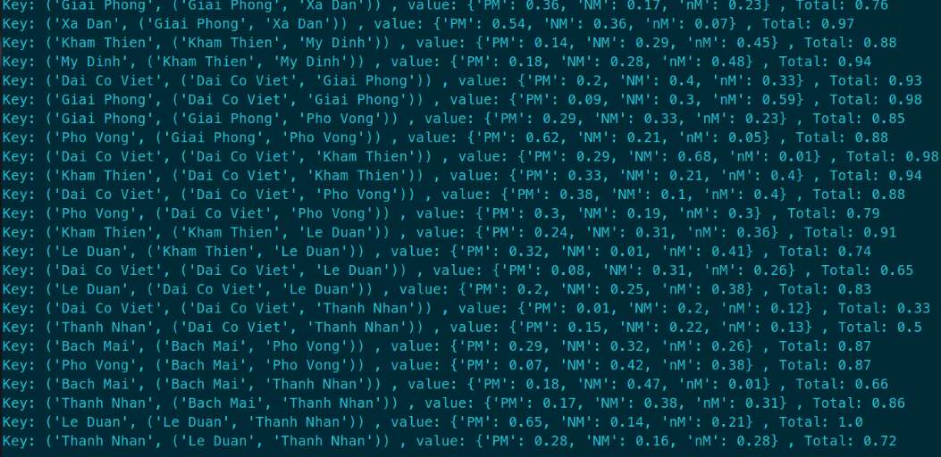
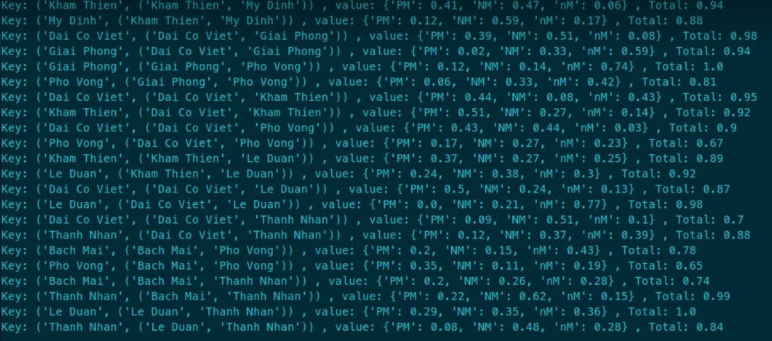
Step 5: Optimization
In fact, the data will always change to change in real time, so after moving from one point to another point, the data is not like it at the start.
Repeat the algorithm at each point in the path we find until reaching the destination.

Slide 11
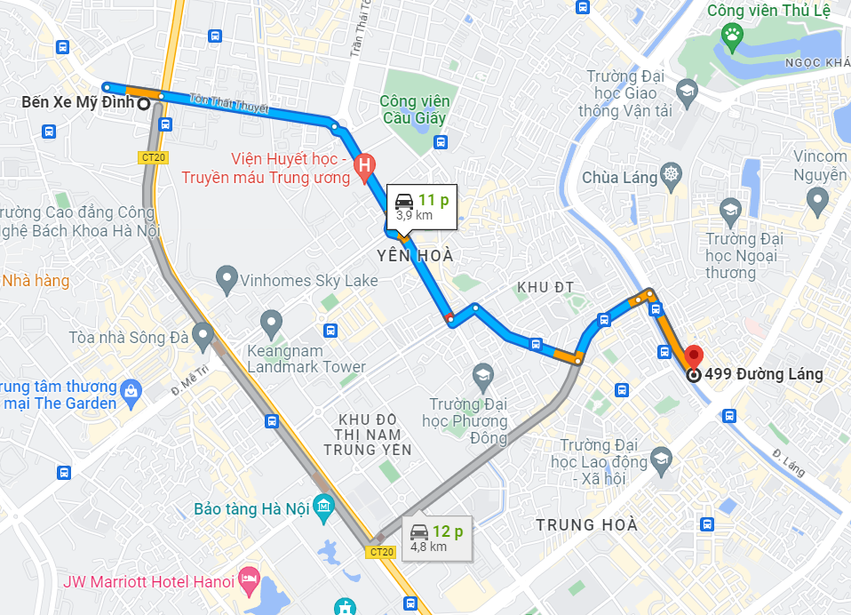
Expected results
Convert the selected route into a format that vehicle owners can understand, such as GPS coordinates or directions on Google Maps.

Slide 12
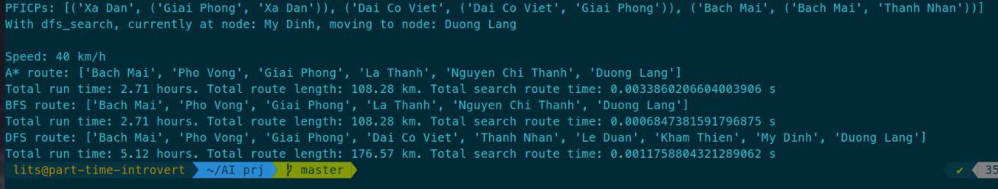
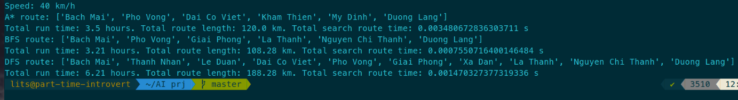
Experiment and evaluation
Here is the table of time algorithms run in small datasheet:
Total route length:
DFS>A*>=BFS
Total code run time: A*>DFS>BFS

Slide 13

Conclusion
This project aims to find the optimal route for vehicles by using a combination of PFIG, A*, BFS, and DFS algorithms. The expected result is to identify routes with the best criteria such as shortest travel time, least fuel consumption, and avoiding congestion. The experiments and evaluations of algorithm running times will provide detailed insights into the effectiveness of the methods used.

Slide 14
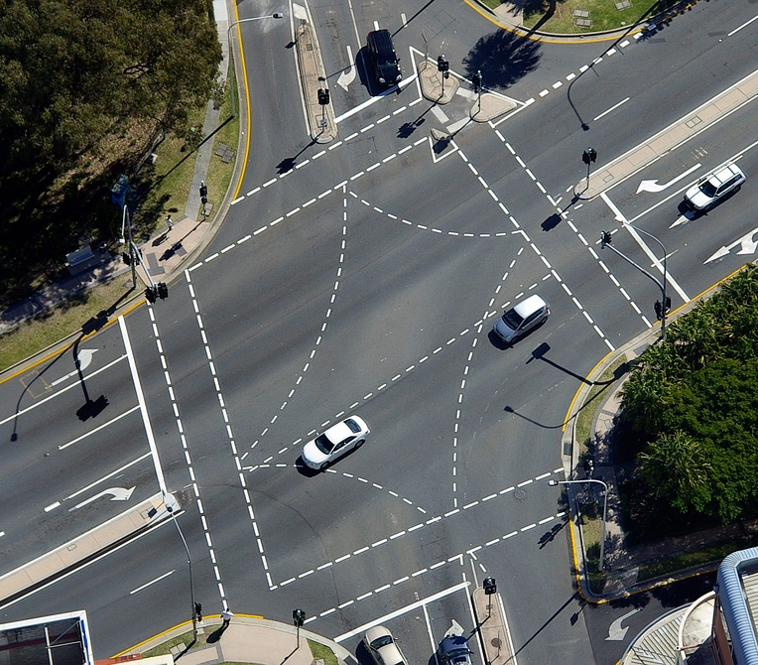
THANK YOU for watching!!!

